Slide 1
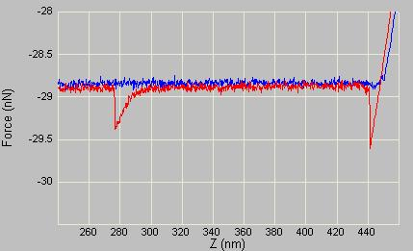
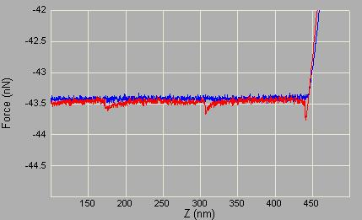
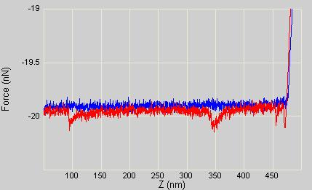
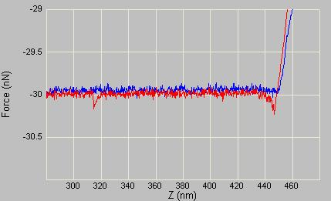
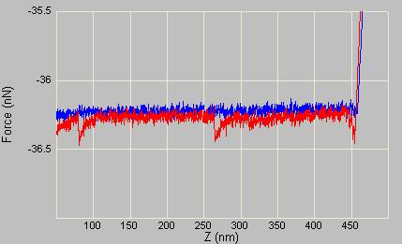
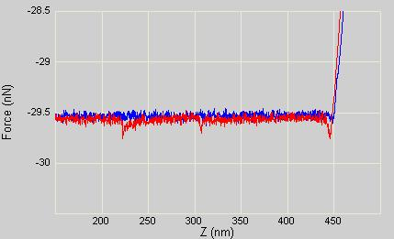
Pulling on type I collagen
What type of events can be observed
Single event
Multiple events repeated at regular intervals
Multiple events repeated at non-regular intervals
Occurrence: 91%
Occurrence: 5%
Occurrence: 4%
03-10-06

Slide 2
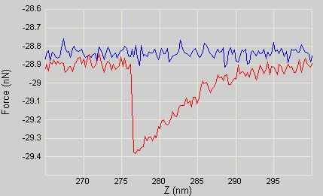
Pulling on type I collagen
How are the curves analysed…
Direct Analysis without any modelling included
Extract the characteristic length of the events
Extract the force required to obtain a pulling event
Force: F
Characteristic Length : L
03-10-06

Slide 3
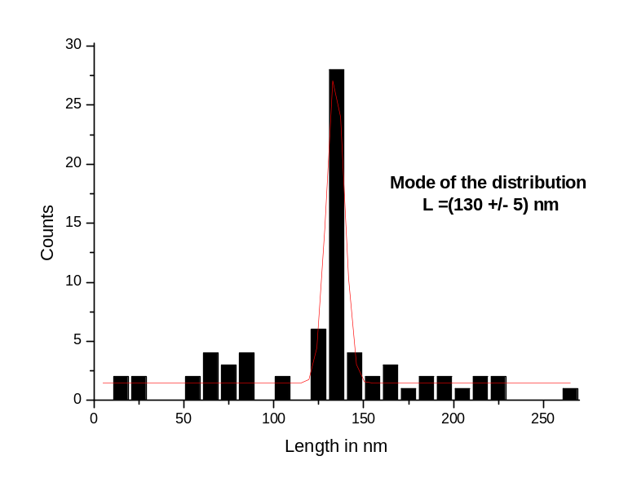
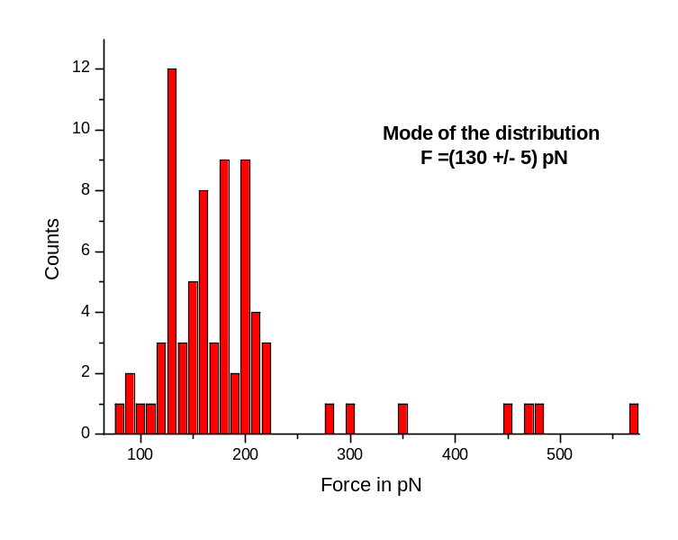
Pulling on type I collagen 10 μg/ml in PBS
Parameters :
Lever : microlever (3rd one) air : 0.2113N/m peak @16kHz liquid : 0.1335N/m peak @ ~3.5kHz
Freq :0.842Hz
Pulling length 500nm,
Deflection sens. :36.96nmV
sampling : 2048
03-10-06

Slide 4
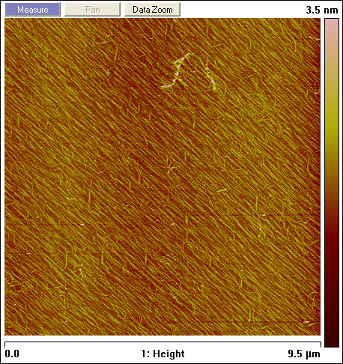
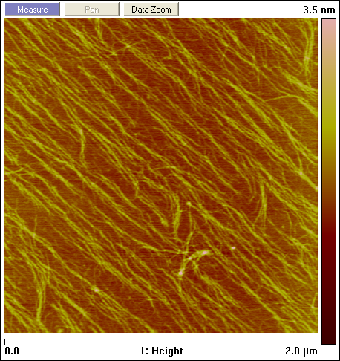
Confirmation of the surface coverage
Micro cantilever tips (Olympus) : RF : 337.7, DA 31.6mv for RMS=1.47
03-10-06

